Slide 1
Economy
How to kick start GS preparation?
How to prepare Economy?
Banking: Monetary policy
All PowerPoint Slides available at Mrunal.org/Download

Slide 2
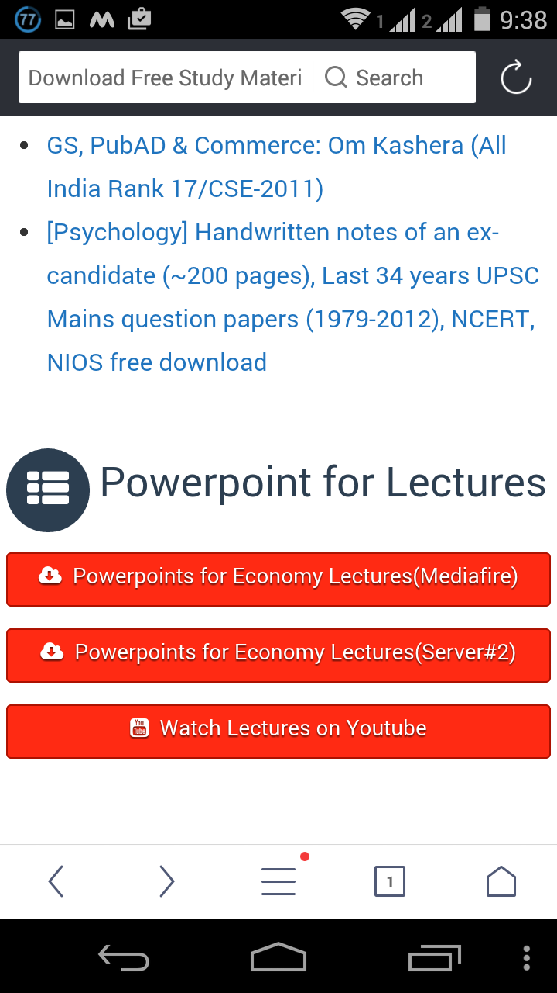
Mrunal.org/download use Mediafire link for mobile/tablets

Slide 3
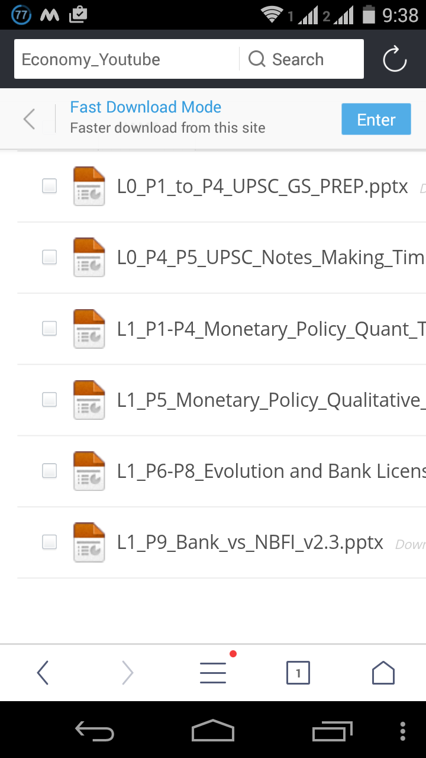
App: UC browser

Slide 4
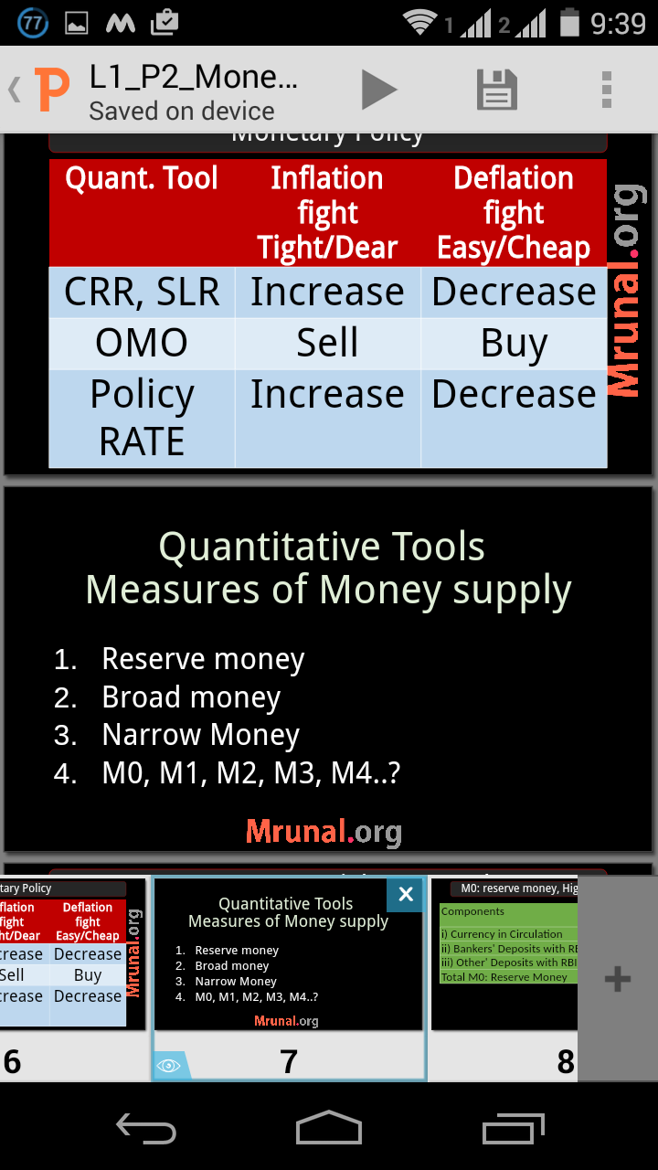
App: Quickoffice to view powerpoints

Slide 5
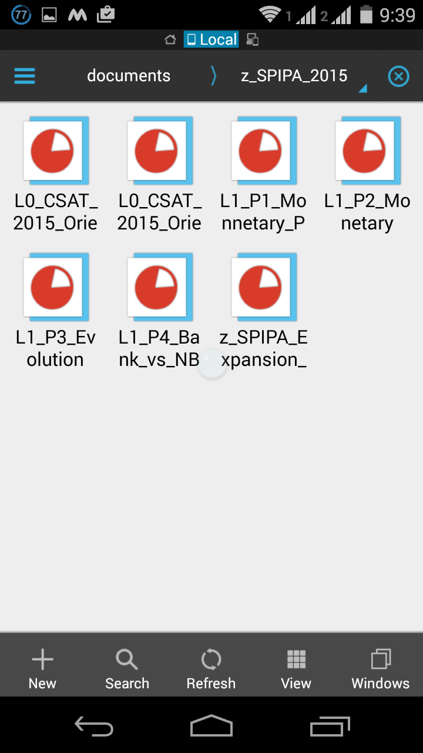
App: ES-explorer for file-management between desktop vs mobile (over wifi-LAN)

Slide 6



7 Pillars of Economy for UPSC
Pillar #1: Basics of Micro & Macro & Indian Economy
Class11
Types of Economies
LPG reforms
Class12: MACRO
GDP, NNP
National income
Money & banking
Class12- MICRO
Selected only
Mrunal.org/economy

Slide 7
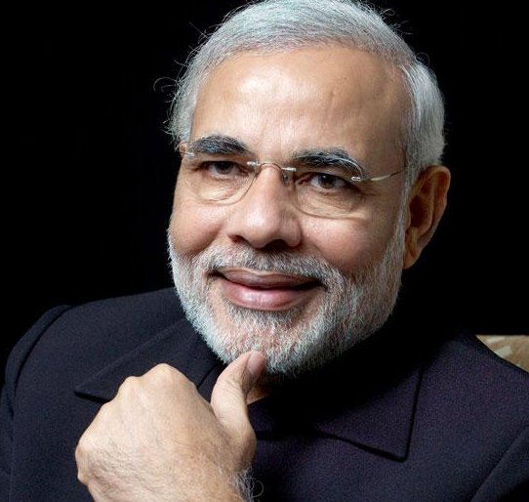
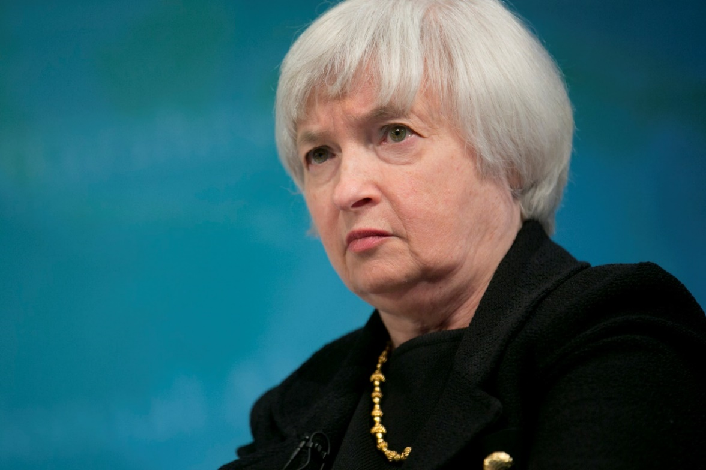

7 Pillars of Economy
2. Banking-Finance
Monetary Policy
Banking Sector
Capital Market
3. Fiscal Policy
Budget, Taxation-GST
Subsidies
Fiscal Deficit
14th FC
4. International
BoP, CAD
WTO & other Org.
Policies affecting
GS Mains P2

Slide 8
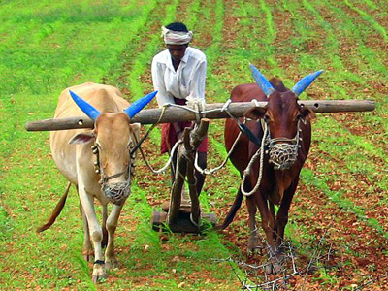

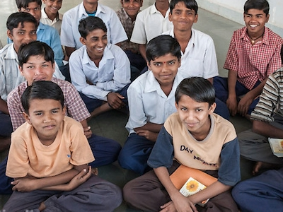
After economic survey is out
5. Sectors of Economy
Agriculture
MSME, Industries
Service sector
GDP, Inflation
6.Infrastructure
Energy
Transport
RUR-URBAN
7. HRD
Skill Development
Poverty line
Weaker sections

Slide 9
Type #1: 7 Pillar focus
CSAT, CAPF, CDS
RBI –Grade “B” Officer Mains
GPSC Mains GS-Economy; similar state service exams

Slide 10
Type #2: firefighting sufficient
Focus area
IBPS: PO/MT, Clerk, Specialist
SBI Clerk/ PO
RBI assistant
Insurance AO, Assistants
SSC (+ theory focus)
Banking-finance (Theory current)
Budget, Schemes
Current: Business-GK, PIN
Then focus on Maths-Reasoning-DI-english

Slide 11
Non-UPSC
UPSC
8th Pillar: Persons in News (PIN), BusinessGK
economy focus on
Facts
Figures
Dates
Names
Numbers
PIN not asked. Hardly 2-3 MCQs in CSAT-2014
Economy Focus on
Principles, Definitions
Cause-consequence
Jurisdiction, features
Pro-Anti

Slide 12
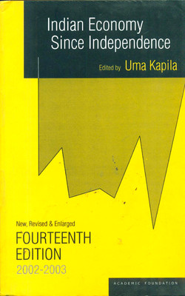
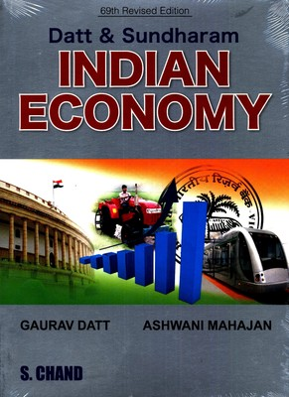
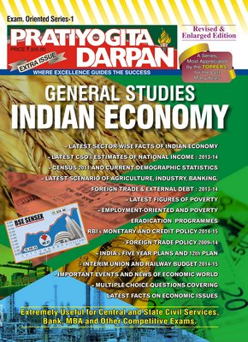
Not Essential for Economy

Slide 13
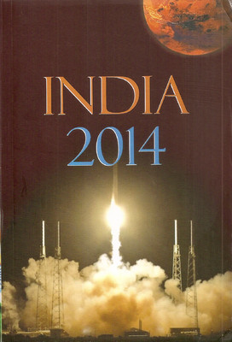
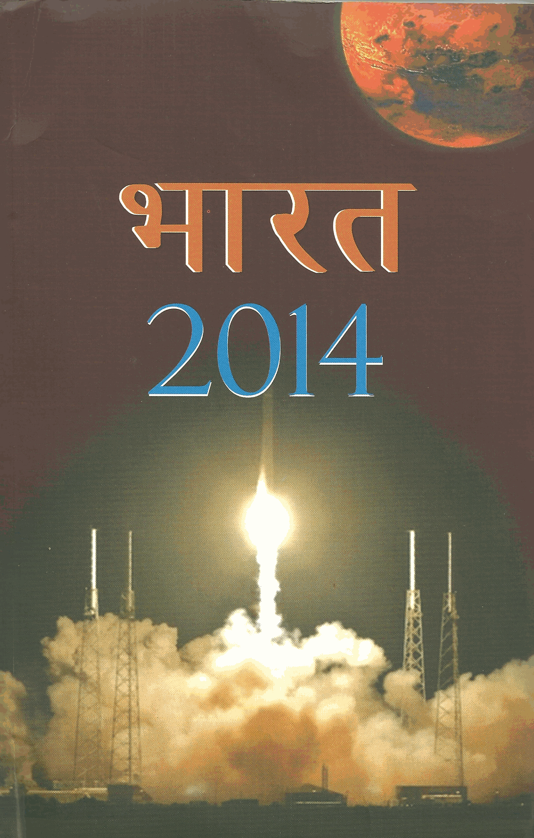
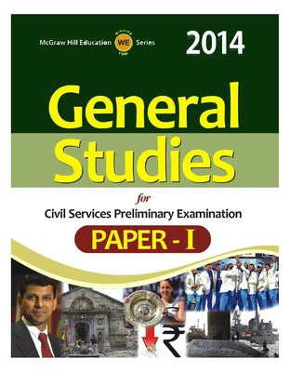

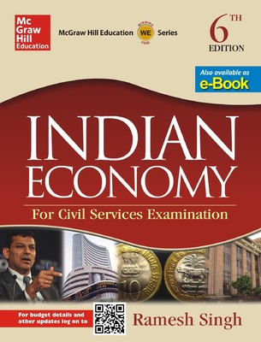
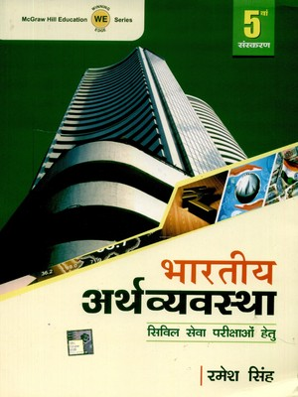


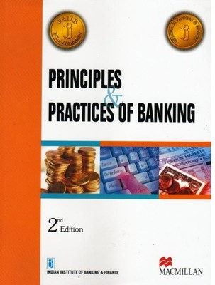
Economy: Dutt Sundaram, Uma Kapila
Budget Speech
Economic Survey
Newspaper

Slide 14
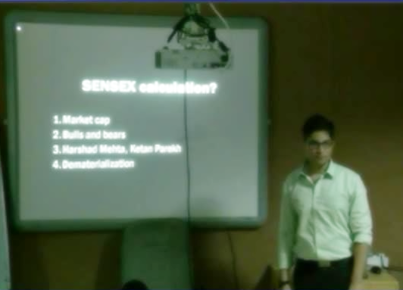
Source of preparation
NCERT 11, 12
Lecture + Mrunal.org
Budget +Survey
Hindu/IndianExpress
(10 Questions in CSAT-14)

Slide 15
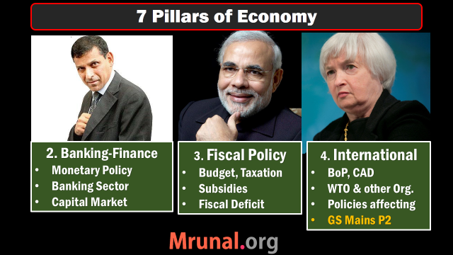
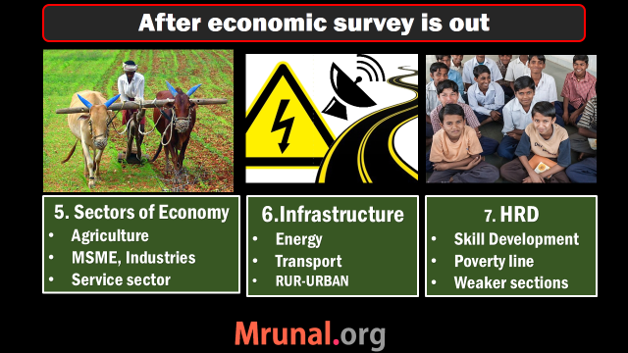
Today’s topic:
Banking ► Monetary Policy
Quantitative | Qualitative tools
CRR, SLR, OMO
Repo, Reverse Repo,
MSF, LAF,
Reforms

Slide 16

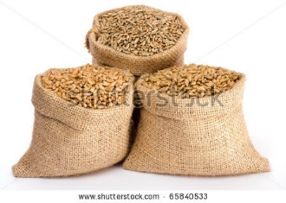

Before money was invented
Double
Coincidence
Of wants
2 kg
500 gms

Slide 17




Birth & Evolution of money

Slide 18
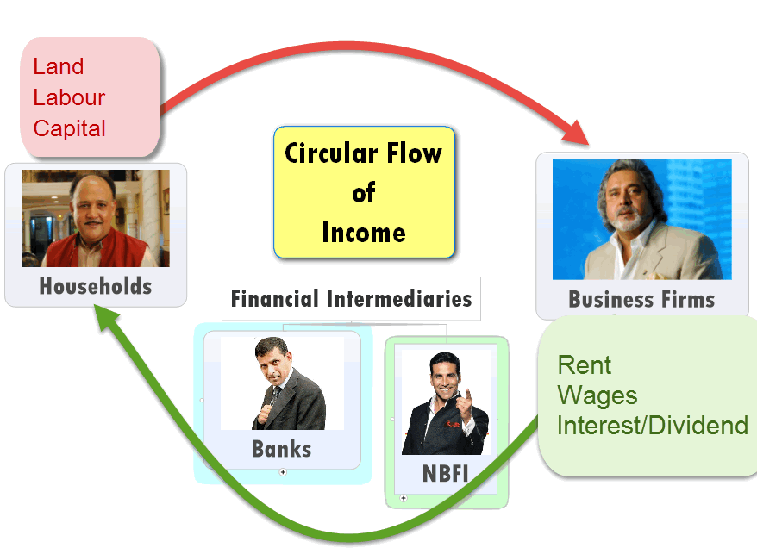

Slide 19
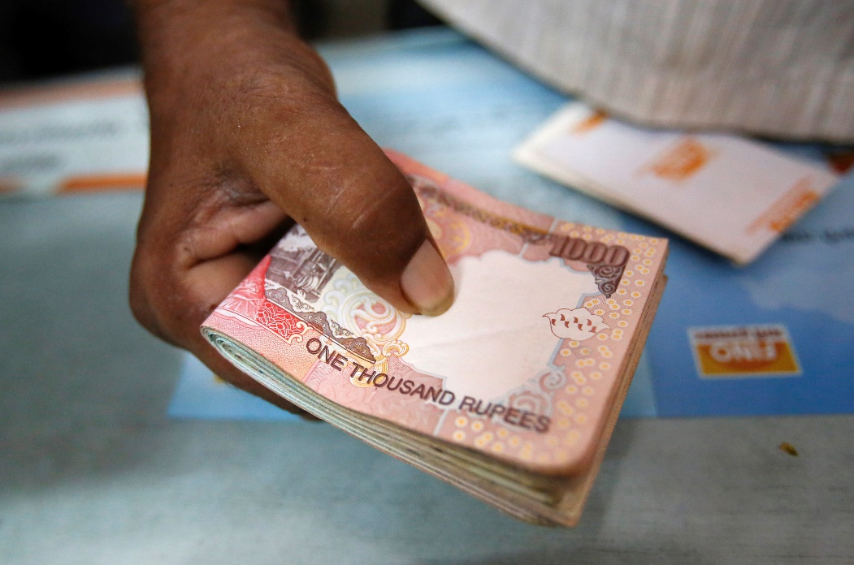
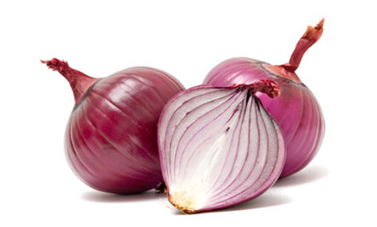
Supply Demand
1 kg = Rs.100
Supply
Demand

Slide 20




Inflation
Demand
Demand
1 kg = Rs.1000
Supply
Demand
Demand

Slide 21
Inflation: ▲ ▲ supply
Demand
Demand
1 kg = Rs.100
Supply
Demand
Demand

Slide 22
Reduce demand by ▼ money supply
Demand
Demand
1 kg = Rs.100
Supply
Demand
Demand

Slide 23
Combat Inflation
Deflation Combat
Reduce Money supply
Tight Money policy
Dear money policy
▲ ▲ Money supply
Easy Money policy
Cheap money policy
Notes:
if prices are constantly dropping, consumers will delay spending. Why buy that F-150 today when it will be effectively "cheaper" next week?

Slide 24
Monetary Policy: Instruments?
Quantitative
Qualitative
Reserve Ratios (CRR, SLR)
OMO: Open market operations
Rates (Repo, RR, Bank, MSF, LAF)
Margin / LTV
Consumer Credit control / Down payment
Rationing
Moral Suasion
Direct Action

Slide 25
Reserve Ratios
Cash Reserve Ratio (4%)
Statutory Liquid Ratio (21.5%)

Slide 26
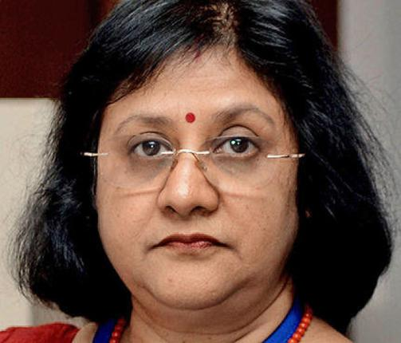

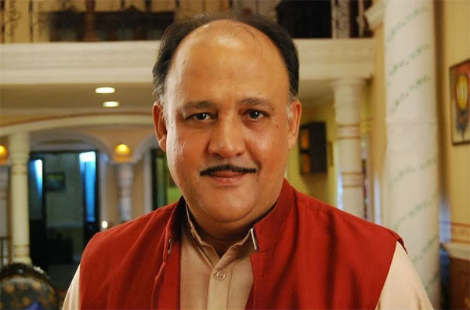
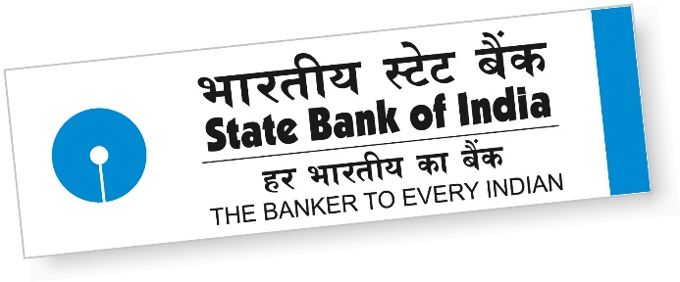

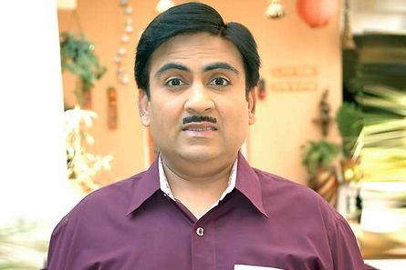
Reserve Ratios
Pay 0-4-9%
Pay 10-15-18%
Depositors
Borrowers
CRR: 04%
SLR: 21.5%
Total: 25.5%

Slide 27
Liabilities of a Bank
Demand
Liabilities
Time
Liabilities

Slide 28
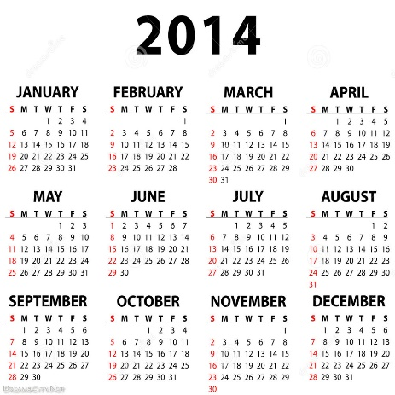
Reserve ratio counted on NDTL
Demand Liabilities
Time liabilities
Current Account (CA)
Savings Account (SA)
Demand Draft
~8,000 Billion Rs.
Fixed deposits (FD)
Recurring deposits (RD)
Cash certificates
Staff security deposits
~78,000 Billon Rs.

Slide 29

1/1/2015
Depositors
Deposited
+120 Cr.
Took out
20 Cr.
Net Demand & Time Liability (NDTL)
120-20=100 Crores.

Slide 30

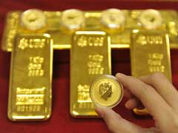

Time: FDRD
NDTL (100 Crore)
Demand: CASA
CRR
4%
SLR
21.5%
Cash, Gold
RBI approved securities
Can’t lend
No profit

Slide 31
Cash Reserve Ratio (CRR)
Deposit | Examples
Time Deposit | FDRD
Demand Deposit | CASA
NDTL | +100 cr.
Reserve ratio
CRR | (-) 4% [no profit]
All Banks
Penalty
No profit. Except 1999.
Right now 4%
IIM-A Prof D'Souza report: allow gold-forex investment
RBI said No, due to volatility

Slide 32
Statutory Liquidity Ratio
Deposit | Examples
Time Deposit | FDRD
Demand Deposit | CASA
Net Demand and Time Liabilities (NDTL) | +100 cr.
Reserve
CRR | (-) 4 [no profit]
SLR | (-) 22 [some profit]
Money left with bank | =74 cr.
All banks
In Cash, gold, RBI approved securities
Some “profit”.
Right now 21.5%

Slide 33
Fortnight lag
Fortnight
Fortnight
Friday
NDTL
100 Cr.
Friday
Friday
4 cr. CRR
21.5 cr. SLR

Slide 34
Reserve Ratios
What is NDTL?
What are SLR and CRR?
How to use them against inflation & deflation

Slide 35
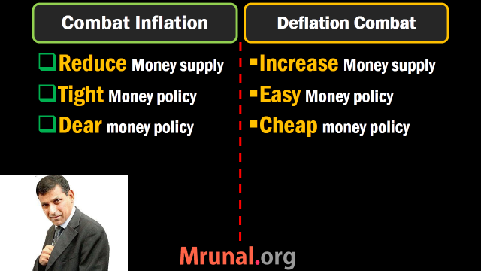

Slide 36
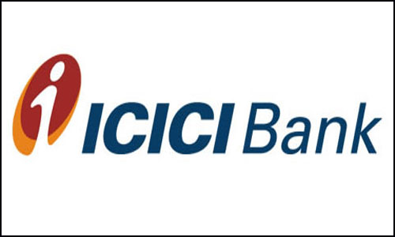
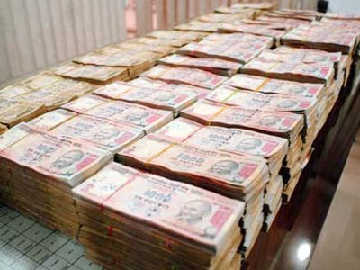
Cyclic fluctuation: Inflation
CRR, SLR: 0%
Loan: 10%
10% of 2 crore
=20 lakh rupees
To combat inflation: REDUCE Money supply

Slide 37
Cyclic fluctuation: Inflation
CRR, SLR: 50%
Loan: 10%
10% of 1 crore
=10 lakh rupees
20% of 1 crore
=20 lakh rupees
To combat inflation: REDUCE Money supply

Slide 38
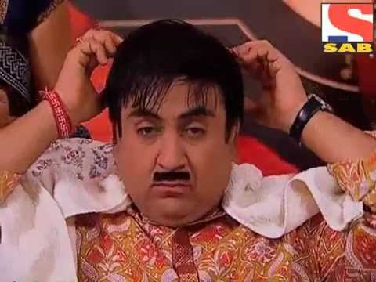

Hike in Bank Loan Interest Rates
10%
20%
50,000/-
48,000/-

Slide 39
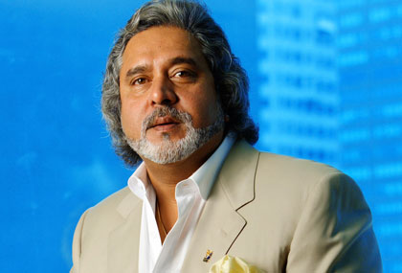
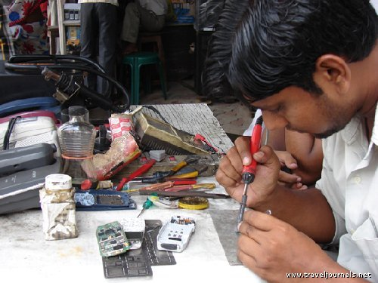



Hike in Bank Loan Interest Rates
10%
20%

Slide 40
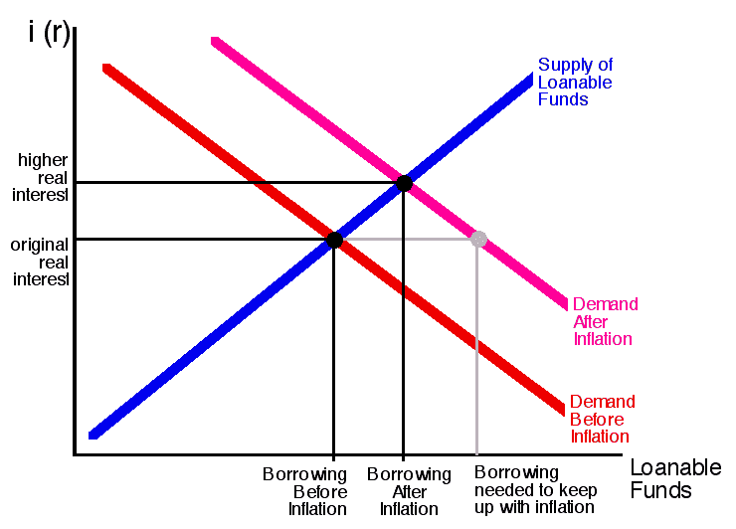

Slide 41
Inflation
Deflation
RBI ▲ CRR/SLR
Banks left with less money to lend
▲ interest rates to keep Profit margin same
People borrow ▼
demand ▼
Prices ▼
= Inflation controlled
RBI ▼ CRR/SLR
Banks are left with more money
They ▼ interest rates to get new clients
People borrow ▲
Demand ▲
= Price ▲

Slide 42
Monetary Policy: Quantitative Tools: Reserve Ratios
 | Inflation fight
HOW? | Tight | Dear
CRR, SLR | ▲▲▲ ▲ ▲

Slide 43
Monetary Policy: Quantitative Tools: Reserve Ratios
 | Inflation fight | Deflation fight
HOW? | Tight | Dear | Easy | Cheap
CRR, SLR | ▲▲▲ ▲ ▲ | ▼▼▼ ▼ ▼

Slide 44
Mock Question
Find correct statement(s)?
To combat inflation, RBI should pursue Cheap money policy.
To combat deflation, RBI should ▲ ▲ Statutory liquidity ratio (SLR)
Both A and B
Neither A nor B

Slide 45
Mock Question
Find correct statement(s)?
To combat inflation, RBI should pursue Cheap money policy. (WRONG: follow DEAR/TIGHT)
To combat deflation, RBI should ▲ ▲ Statutory liquidity ratio (SLR) (WRONG: should ▼ ▼ SLR)
Both A and B
Neither A nor B (Correct Answer)

Slide 46
Mock Question
Find incorrect statement(s)?
To combat inflation, RBI should pursue Cheap money policy. (WRONG: follow DEAR/TIGHT)
To combat deflation, RBI should ▲ ▲ Statutory liquidity ratio (SLR) (WRONG: should ▼ ▼ SLR)
Both A and B (Correct Answer)
Neither A nor B

Slide 47
Mock Question UPSC 2010
When RBI ▲ ▲s CRR, It means ___.
RBI will have less money to lend
Government will have less money to spend.
Commercial banks will have more money to lend
Commercial banks will have less money to lend

Slide 48
Mock Question UPSC 2010
When RBI announces an ▲ ▲ of Cash reserve ratio, what does it mean?
RBI will have less money to lend (irrelevant)
Union government will have less money to spend. (irrelevant)
Commercial banks will have more money to lend (wrong. Reverse will happen)
Commercial banks will have less money to lend (right)

Slide 49
Bi-monthly | 2014 | Bank Rate | MSF | Repo | RR | SLR | CRR
first | April |  |  |  |  | 23 | 4
second | June |  |  |  |  | 22.5 | 4
third | August |  |  |  |  | 22 | 4
fourth | Sep |  |  |  |  | 22 | 4
Fifth | Dec |  |  |  |  | 22 | 4
Surprize | 15/1/15 |  |  |  |  | 22 | 4
Sixth | Feb,15 |  |  |  |  | 21.5

Slide 50
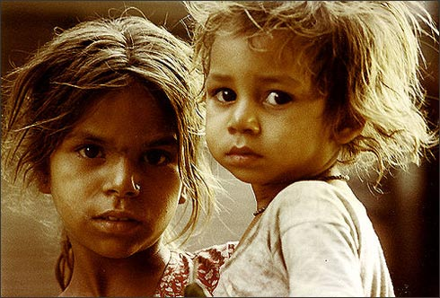
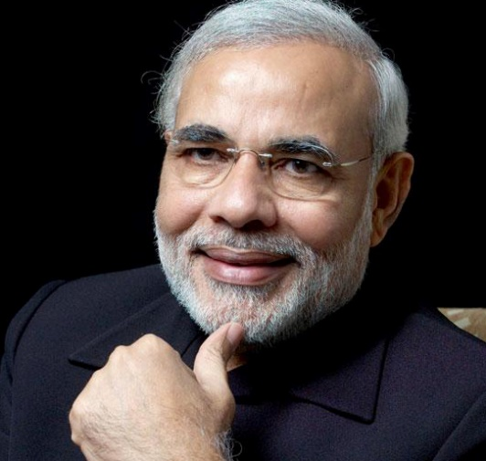
Reserve Ratios
SLR
RBI
Reduced SLR
To flow money in
Productive sectors of Economy
Promised fiscal consolidation

Slide 51

Both counted on NDTL
Have to set aside this much cash in reserve.
Profit? NO!
TIME(FDRD)
Demand (CASA)
Bank Rate 8.25
MSF
8.25
Repo 7.25
RR 6.25
SLR 21.5%
CRR 4%
Banks have to keep this much in cash, gold, G-sec & other RBI approved securities. Profit? YES

Slide 52
Monetary Policy Quantitative tools
Reserve Ratio (CRR, SLR)
Open Market operation (OMO)

Slide 53

Government securities

Slide 54
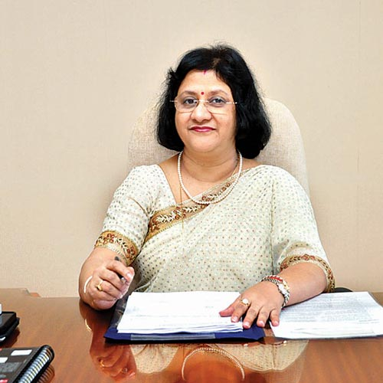

Inflation: Open Market Ops.
To combat inflation, RBI has to reduce money supply

Slide 55
Inflation: Open Market Ops.

Slide 56
Why would banks bother with OMO?
Pay 0-4-9%
Pay 10-15-18%
Depositors
Borrowers
Idle money
=LOSS MAKING
Must invest
G-Sec: 8%

Slide 57
Liquidity / money supply
▼ ▼d
▲ ▲d

Slide 58
Quant. Tool | Inflation fight Tight/dear
CRR, SLR | ▲ ▲
OMO | Sell
To fight inflation,
I’ve to ▼ ▼ money supply from the system

Slide 59
Quant. Tool | Inflation fight Tight/dear | Deflation fight Easy/ Cheap
CRR, SLR | ▲ ▲ | ▼ ▼
OMO | Sell | Buy

Slide 60
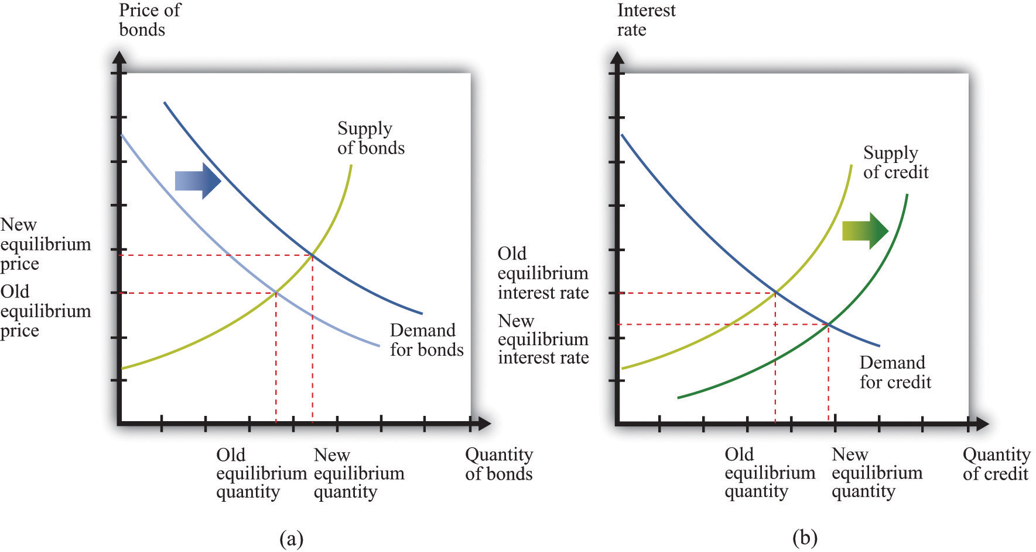

Slide 61
MCQ (UPSC-2013)
In context of Indian Economy, ‘Open Market Operation’ refers to
Borrowing by scheduled banks from RBI
Lending by commercial banks to industries and trade
Purchase and sale of government securities by the RBI
None of Above

Slide 62
MCQ (UPSC-2013)
In context of Indian Economy, ‘Open Market Operation’ refers to
Borrowing by scheduled banks from RBI (Repo/Bank)
Lending by commercial banks to industries and trade (irrelevant)
Purchase and sale of government securities by the RBI (RIGHT)
None of Above

Slide 63
Which of the following will ▲ ▲ Money supply in the economy?
Purchase of government securities from public by central bank
Deposit of currency in commercial banks by the public
Borrowing by government from the central bank.
Sale of government securities to the public by central bank.
CSAT-2012
Answer Choices
Only 1
2 and 4
1 and 3
2, 3 and 4

Slide 64
Which of the following will ▲ ▲ Money supply in the economy?
Purchase of government securities from public by central bank
Deposit of currency in commercial banks by the public
Borrowing by government from the central bank.
Sale of government securities to the public by central bank (Bhai) (▼ ▼S Money supply)
CSAT-2012
Answer Choices
Only 1
2 and 4
1 and 3
2, 3 and 4

Slide 65
Which of the following will ▲ ▲ Money supply in the economy?
Purchase of government securities from public by central bank (right)
Deposit of currency in commercial banks by the public
Borrowing by government from the central bank. (Public finance)
Sale of government securities to the public by central bank (▼ ▼S Money supply)
CSAT-2012
Answer Choices
Only 1
2 and 4
1 and 3
2, 3 and 4
Test series “A”, Q77, Ans.C
1. Skip 2. Attempt 3. Mark n Review

Slide 66
Monetary Policy Quantitative tools
Reserve Ratio (SLR, CRR)
Open Market operation
Rates: Bank Rate, Repo Rate, MSF, LAF

Slide 67


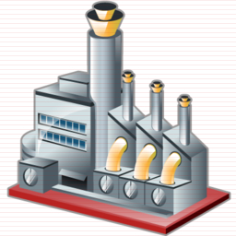
Bank Rate: Meaning?
Long term Loan
Interest rate: 9%
BANK RATE
Collateral: Nothing

Slide 68
Bank Rate 3%
Loans 5%
Bank Rate 36%
Loans 48%
Less demand
Inflation controlled

Slide 69
Monetary Policy
Quant. Tool | Inflation fight | Deflation fight
CRR, SLR | ▲ ▲ | ▼ ▼
OMO | Sell | Buy
Bank RATE | ▲ ▲ | ▼ ▼

Slide 70
Bank Rate: WHY?
Not the main tool to control money supply these days.
Bank rate is Linked with penal rates:
If CRR, SLR not maintained:
Penalty= (Bank rate + 3%); 5%

Slide 71
CRR, SLR Fortnight lag
Fortnight
Fortnight
Friday
NDTL
100 Cr.
Friday
Friday
4 cr. CRR
21.5 cr. SLR
Otherwise penalty
Bank Rate + 3%
Bank Rate + 5%

Slide 72
Have to set aside this much cash in reserve.
No Profit
Long term loan from RBI without collateral
Bank Rate
MSF
R+1
Repo R%
RR R-1
SLR
CRR
LAF
NDTL
Banks have to keep this much in cash, gold, G-sec & other RBI approved securities. Some profit

Slide 73
LAF: Liquidity Adjustment Facility (2000)
Collateral? = Government security.
LAF | Short term loans.
Repo | When clients borrow from RBI. 8%
Reverse Repo | When clients deposit money in RBI. 8-1=7%

Slide 74
Repo Rate: Meaning?
Repo Rate 8%
100 crore
SBI to Repurchase
@108 Cr.
After 7 days
Collateral: G-Sec
But not from SLR

Slide 75
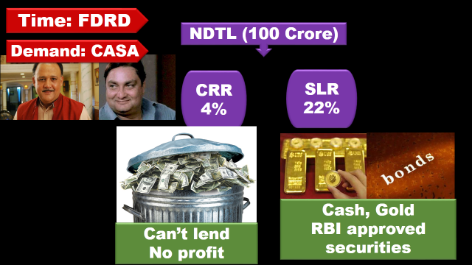

Bank can’t use these G-sec to borrow under Repo

Slide 76
What’s the difference?
LAF (Repo)
MSF
Minimum 5 cr
All clients eligible
Central & State Government
All Banks
NBFI (LIC, UTI)
1 cr.
Only scheduled commercial banks can bid.
Paid up cap. 5l, protect interest of depositors=> RBI Act 1934, 2nd Sch.

Slide 77
LAF (Repo)
MSF
Bank cannot use SLR quota securities
No limit. Borrow according to your securities.
R%
Can use
Maximum limit 0.75% NTDL.
R+1%

Slide 78
Bank use these G-sec to borrow under MSF
0.75% of NDTL
=75 lakh borrow

Slide 79
Reverse Repo Rate: Meaning?
Reverse Repo Rate 7%
100 crore
RBI to Repurchase
@107 Cr.
After 7 days
Collateral: G-Sec
But not from SLR

Slide 80
Reverse Repo
Reverse repo rate = “it is interest rate paid by RBI to its clients for short term loans.”
Central & State Government, All Banks, NBFI
Collateral: government securities
2011: RR = Repo – 1% (100 basis points).
Dec 2014: Repo = 8%.
Reverse repo =8-1=7%

Slide 81
Reverse Repo -1%
Repo (R%)
MSF
R+1%
POLICY RATE
1%= 100 basis points
8%- decreased by 25 basis points
8.00-0.25=7.75 (15/Jan/15)

Slide 82
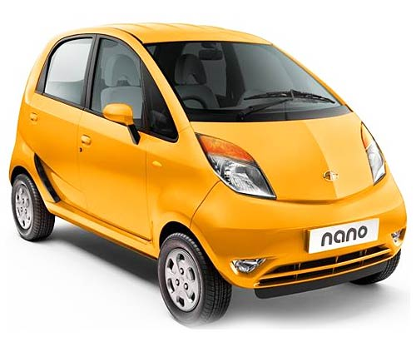
During inflation
Repo Rate 8%
Car Loan 13%
1,00,000

Slide 83
During inflation: Tight money policy
Repo Rate 8%
Car Loan 13%
Repo Rate 18%
Car Loan 36%
70,000

Slide 84
Monetary Policy
Quant. Tool | Inflation fight
CRR, SLR | ▲ ▲
OMO | Sell
Policy Rate | ▲ ▲

Slide 85
Monetary Policy
Quant. Tool | Inflation fight | Deflation fight
CRR, SLR | ▲ ▲ | ▼ ▼
OMO | Sell | Buy
Policy Rate | ▲ ▲ | ▼ ▼

Slide 86
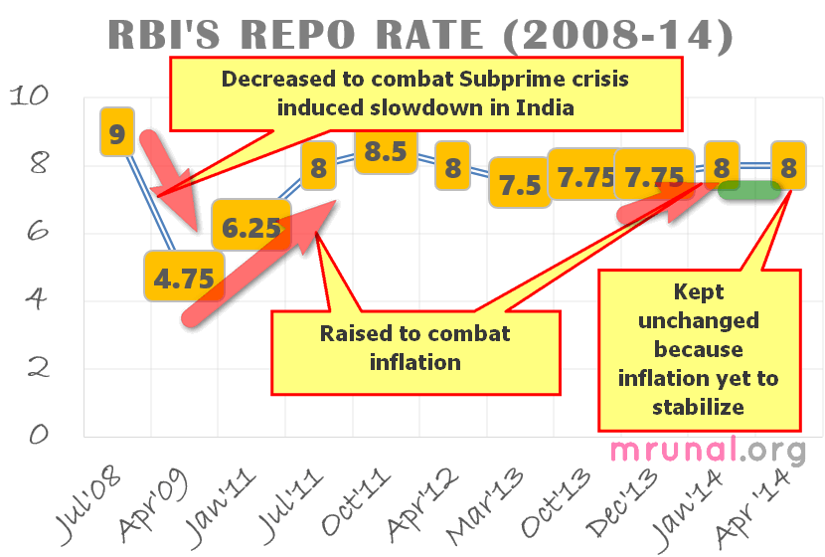

Slide 87
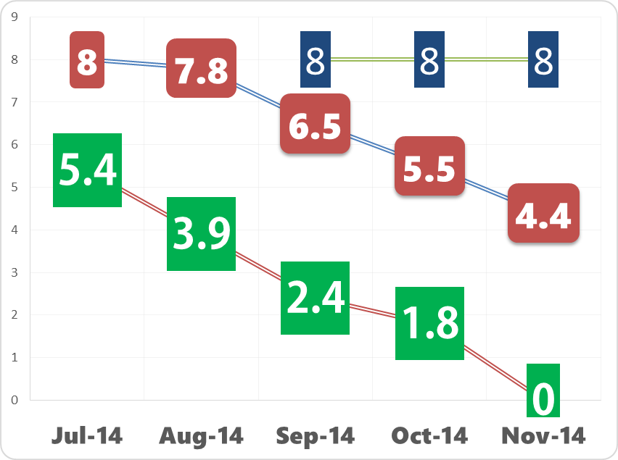
Repo Rate
CPI
WPI

Slide 88
Bi-monthly | 2014 | Bank Rate | MSF +1 | Repo | RR -1 | SLR | CRR
first | April | 9 | 9 | 8 | 7 | 23 | 4
second | June | 9 | 9 | 8 | 7 | 22.5 | 4
third | August | 9 | 9 | 8 | 7 | 22 | 4
fourth | Sept,30 | 9 | 9 | 8 | 7 | 22 | 4
Fifth | Dec, 2 | 9 | 9 | 8 | 7 | 22 | 4
Surprize | 15/1/15 | 8.75 | 8.75 | 7.75 | 6.75 | 22 | 4
Sixth | 3-Feb-15 | 8.75 | 8.75 | 7.75 | 6.75 | 21.5 | 4

Slide 89
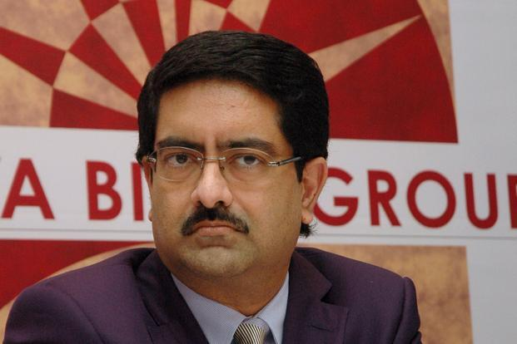
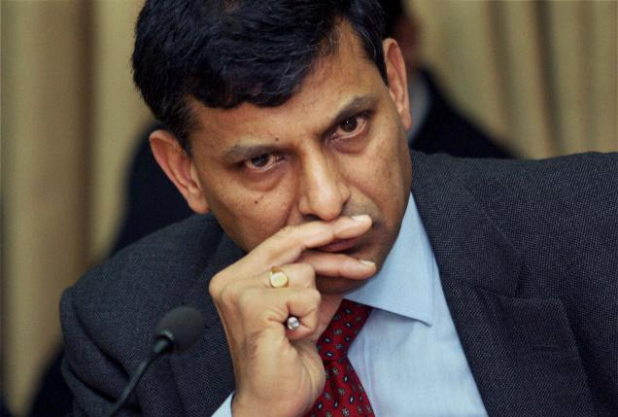
Bi-monthly | 2015 | Bank Rate | MSF +1 | Repo | RR -1 | SLR | CRR
Third | Aug | 8.25 | 8.25 | 7.25 | 6.25 | 21.5 | 4
RBI should decrease policy rate to boost Growth
Banks not passing
Must check inflation

Slide 90
All clients can borrow short term loans from RBI @this interest rate. can’t use SLR securities though!
Have to set aside this much cash in reserve
=no income
Long term loan from RBI
Bank Rate 8.25
MSF
8.25
Repo 7.25
RR 6.25
SLR 21.5%
CRR 4%
Only for Sch. Commercial banks can borrow from RBI @this Interest rate. Can even use SLR securities
What RBI pays to its clients for short term loans
Banks have to keep this much in cash, gold, G-sec & other RBI approved securities

Slide 91
CSAT-2014
The terms 'Marginal Standing Facility Rate' and 'Net Demand and Time Liabilities', are used in relation to
Banking operations
communication networking
military strategies
supply and demand of agricultural products

Slide 92
Limitation of Monetary policy
Why it failed to contain inflation? (2013-14)
Urjit Patel Committee recommendations

Slide 93
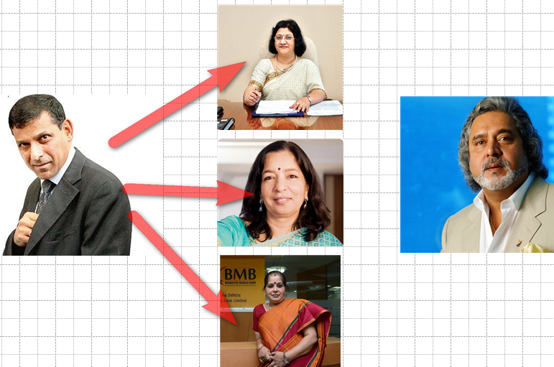
How does Policy rate affects economy?
Notes:
Arundhati bhattacharya, Shikha Sharma MD & CEO. Usha anathasubramium

Slide 94
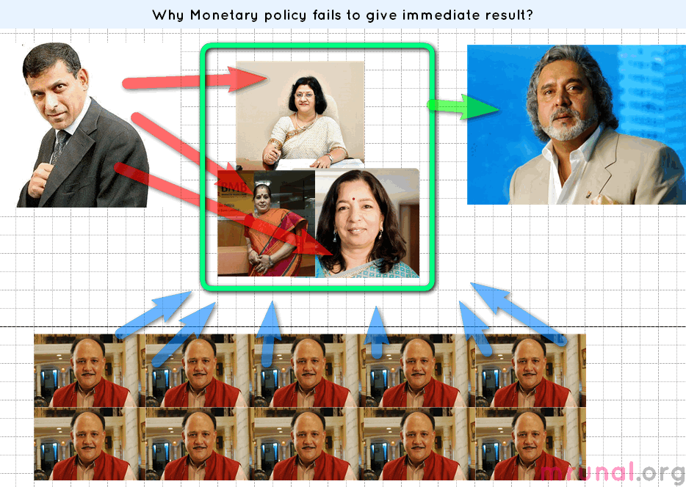
Billion Rs. | 2013
DEMAND | 8,142
TIME | 77,963

Slide 95
Monetary Policy: limitations (Developing-countries)
People don’t have many investment alternatives. So, Commercial banks have high deposits.
Unorganized money market; Shroff; lack of financial inclusion
Monsoon uncertainty, cyclone, flood, draughts => Supply side constrains

Slide 96
Monetary Policy: limitations (Developing-countries)
Crude oil, gold import
Fiscal deficit, subsidy leakage, Black money, underground economy
Solution: Urjit Patel Committee

Slide 97
Committees by RBI
Bimal Jalan
New Bank Licenses
Feb 2014 report given
Nachiket Mor
Financial products for small businessmen and low income household.
Urjit Patel
Revise and Strengthen Monetary policy framework
Financial inclusion: banking, credit, investment, insurance. + consumer protection
RBI board of directors.
Dy. Governor
Retired governor

Slide 98

Monetary Policy Reforms
Urjit Patel
Expert Committee to Revise and Strengthen the Monetary Policy Framework
January 2014 report:
Three Major Recommendation:
RBI inflation targets (2-6%)
Government help RBI
RBI fix accountability

Slide 99
Until Now
Urjit Patel
WPI
But 60% GDP comes from service sector.
Multi-targets: reduce inflation, GDP growth, employment growth….
CPI (All India Urban + Rural)
Minimum inflation: 2%
Maximum 6%
=4% (+/- 2% band)
Similar system in Mexico, S.Africa, Israel

Slide 100

Nominal Anchor 4% CPI: When? Timeframe
Chile:
90s CPI 25%
2000s: CPI target 3% (+/- 1% band)

Slide 101
Nominal Anchor 4% CPI: How? RBI?
Reverse Repo -1%
Repo (R%)
MSF +1%
Policy rate= LAF repo Rate
Decided by voting in MPC.
Reverse repo=-1% (100 basis point)
MSF=+1%
Spread +1/-1 should not be changed frequently
Keep Repo higher than CPI

Slide 102
Monetary policy under Rajan
Bi-monthly Policy | 2014 | MSF | Repo | RR Repo | CPI target
first | April | 9 | 8 | 7 | started
second | June | 9 | 8 | 7
third | August | 9 | 8 | 7
fourth | Sept,30 | 9 | 8 | 7

Slide 103
Monetary policy under Rajan
January | CPI Target
2015 | 8%
2016 | 6%
Challenges:
60% El Nino
Geopolitical problems
Subsidies

Slide 104
Repo Rate
CPI
WPI

Slide 105
Monetary Policy
Urjit Patel
RBI target inflation with deadline
Government should help RBI
RBI’s accountability has to be fixed

Slide 106
Government to help RBI
Urjit Patel
MNREGA: wage ▲ ▲…yes. Productive growth…no?
Subsidy leakage, corruption
Administered price…x
Fiscal consolidation

Slide 107


Slide 108
Monetary Policy: accountability in India
RBI Act.
Governor directly accountable to Government
Govt. can issue directives to RBI in public interest.
Parliament’s standing Committee on finance- can summon Governor Avg. 3-4/year.
Monetary policy made by Governor alone. (sign.)
OVERALL No formal accountability mechanism.

Slide 109


Slide 110
Urjit: Monetary Policy: accountability in India
Target: 4% (2% band)= 2-6% .
Failure?? Three quarters successively.
MPC issue public statement
Each member will sign it
Reasons for failure
Action proposed
Time-frame for result.

Slide 111


Each cluster headed by COO
Dy.Gov. rank
Need Govt. approval
Monetary policy
Regulatory
Supervision
Financial market
Services
Existing dept will be grouped into FIVE clusters

Slide 112
Monetary Policy
NCERT Class12: Macroeconomics
Chapter 3 Money and banking
Ignore complicated graphs-formula-equations
WPI, CPI, IIP, inflation=>L5/P5.pptx

Slide 113
Next
Qualitative tools
Banking sector evolution since British India
Financial inclusion: PM-JDY, KVP etc.

